Slide 1
WEB Application Development
Lab work – 3
WEB API .NET Core
Mongo DB

Slide 2
What is MongoDB
MongoDB is an object-oriented, simple, dynamic, and scalable NoSQL database.
MongoDB uses JSON or BSON documents to store data. General distributions for MongoDB support Windows, Linux, Mac OS X, and Solaris.
JSON stands for JavaScript Object Notation
JSON is a lightweight format for storing and transporting data
JSON is often used when data is sent from a server to a web page
BSON [bee · sahn], short for Bin­ary JSON, is a bin­ary-en­coded seri­al­iz­a­tion of JSON-like doc­u­ments

Slide 3
Terminology and Concepts
SQL Server | MongoDB
Database | Database
Table | Collection
Index | Index
Row | Document
Column | Field
Joining | Linking & Embedding
Partition | Sharding (Range Partition)
Replication | ReplSet

Slide 4


Slide 5
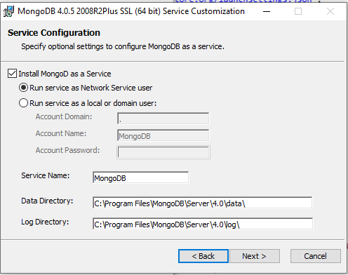

Slide 6
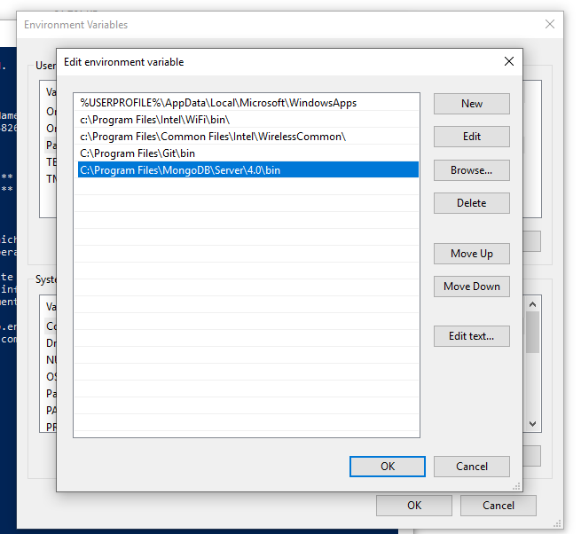

Slide 7
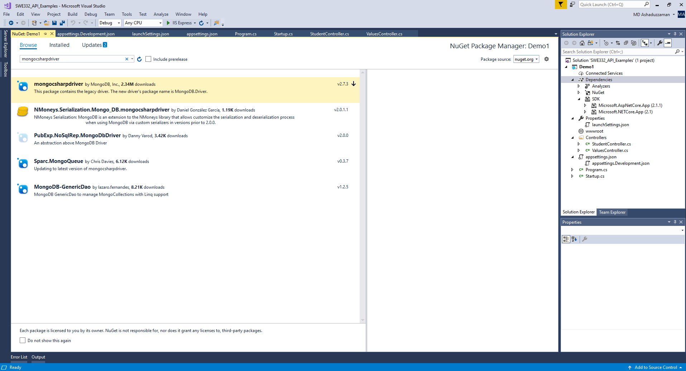

Slide 8
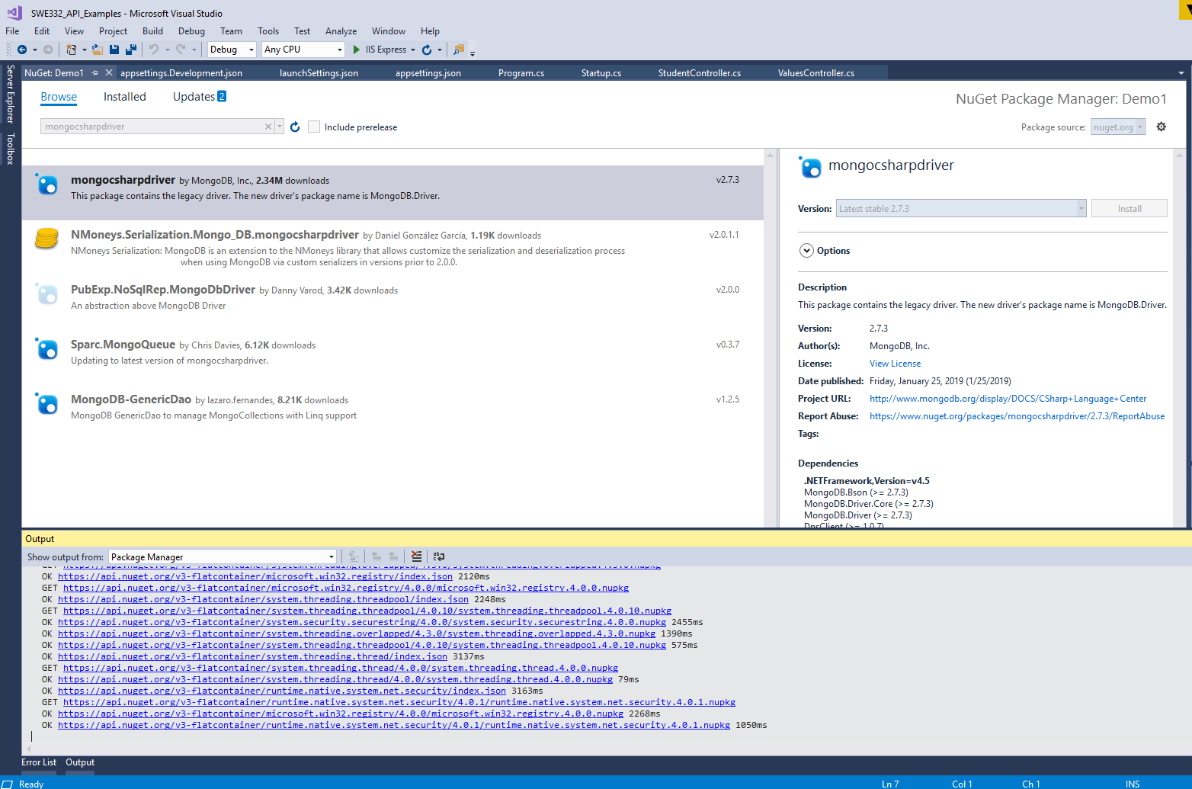

Slide 9
using System;
using System.Collections.Generic;
using System.Linq;
using System.Threading.Tasks;
using Microsoft.AspNetCore.Http;
using Microsoft.AspNetCore.Mvc;
using MongoDB.Bson;
using MongoDB.Driver;
namespace Demo1.Controllers
{
[Route("api/[controller]/[action]")]
[ApiController]
public class StudentController : ControllerBase
{
MongoClient _client;
MongoServer _server;
MongoDatabase _db;
public StudentController()
{
_client = new MongoClient("mongodb://localhost:27017");
_server = _client.GetServer();
_db = _server.GetDatabase("StudentDB");
}
public string getStudentNames()
{
return "Ali";
}
public string getStudentID()
{
return "112";
}
public void SaveStudentInfo() {
var document = new BsonDocument
{
{"property", "10"},
{"address", "this is address 1"},
{"city", "city name"},
};
_db.GetCollection("Students").Save(document); // Stringified JSON Object
}
public IEnumerable<Object> ShowSavedData()
{
return _db.GetCollection("Students").FindAll();
}
}
}

Slide 10
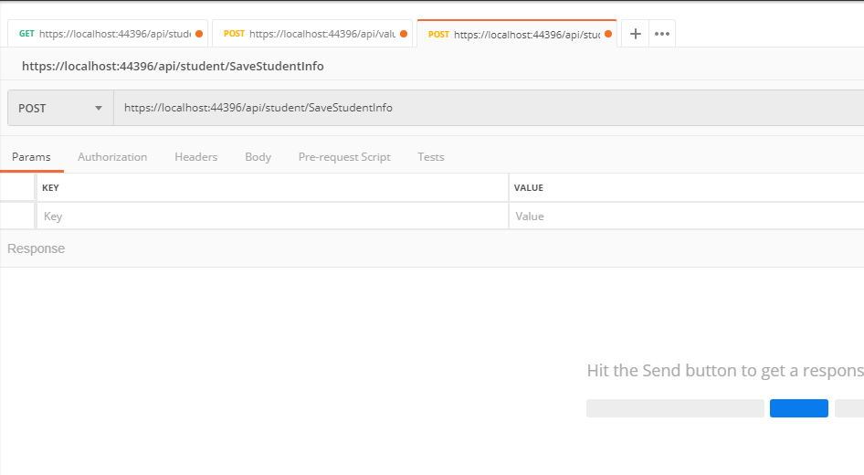

Slide 11
Commands of mongo db
show dbs
use EmployeeDB
db.getCollection('Students')
db.getCollection('Students').find({})

Slide 12
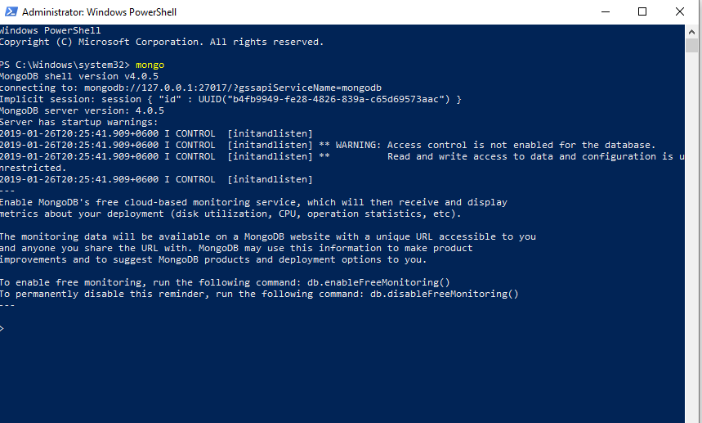

Slide 13
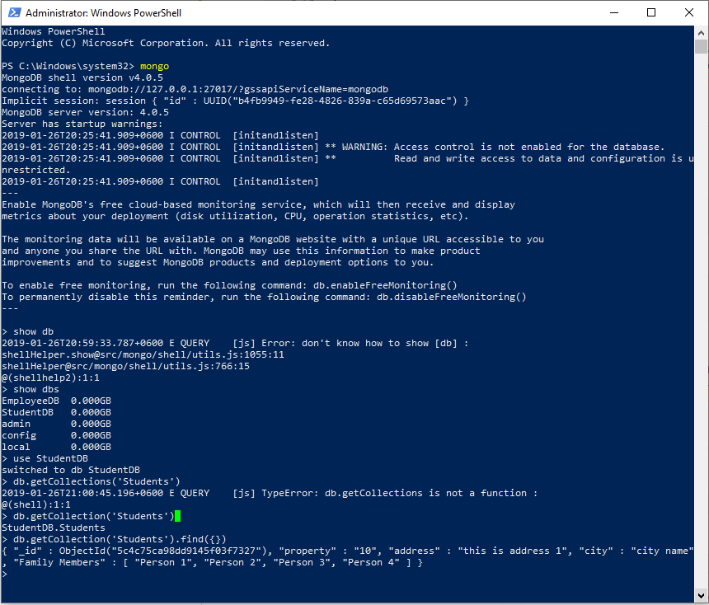

Slide 14
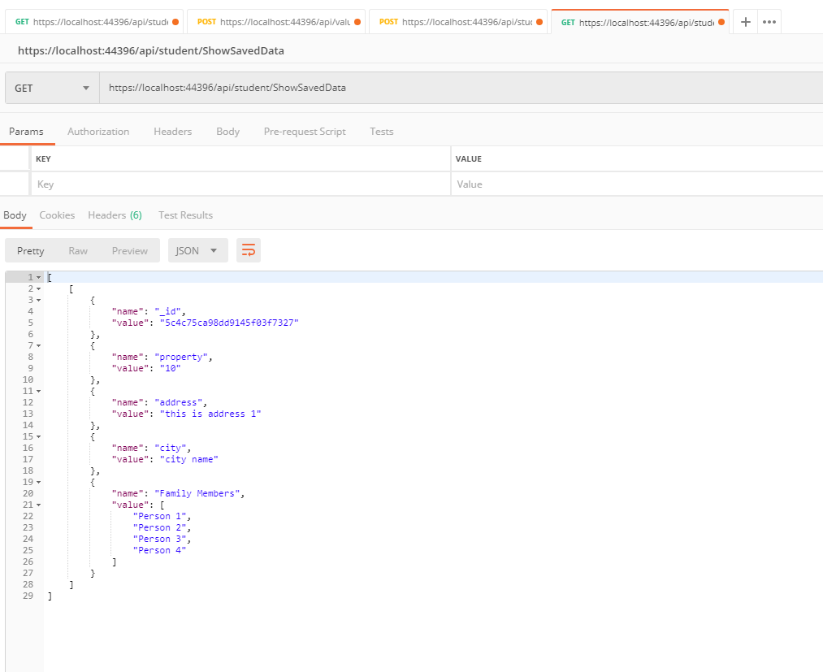

Slide 15
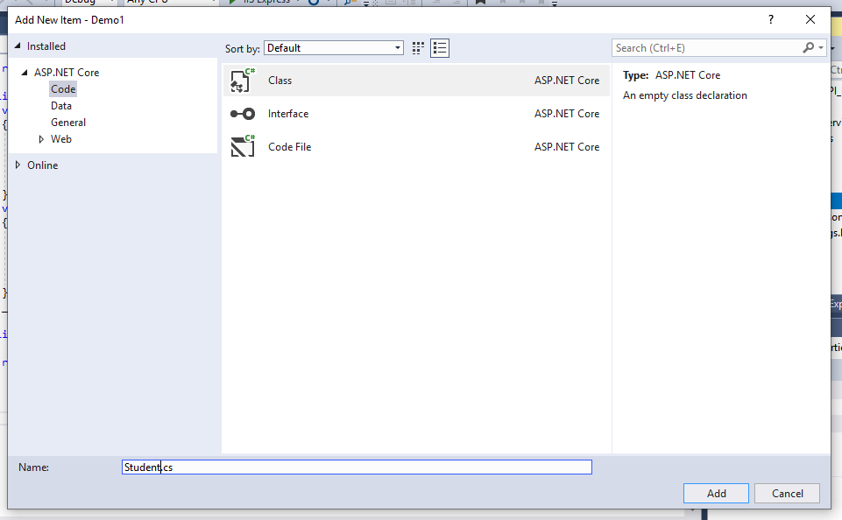
Integrating with class object

Slide 16
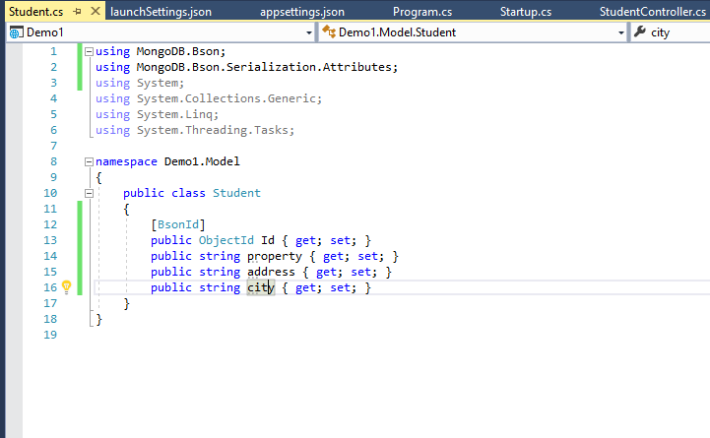

Slide 17
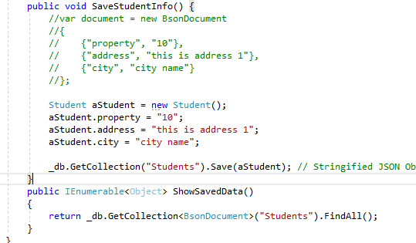

Slide 18
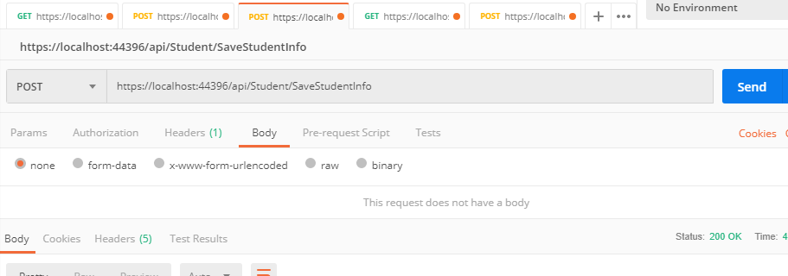

Slide 19
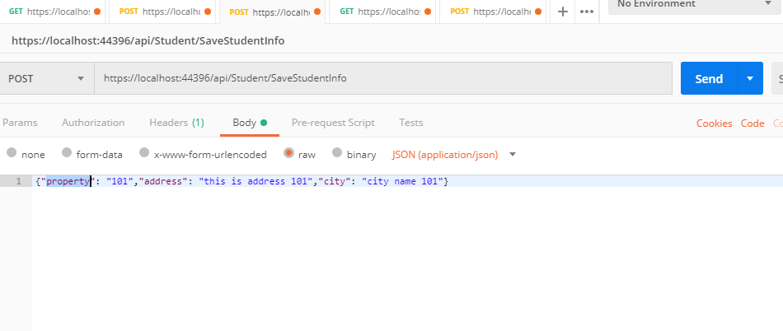

Slide 20
